Slide 1
DIGITAL PORTFOLIO
STUDENT NAME: S.LAKSHAYA
REGISTER NO : 222411301
NMID : asunm1737222411301
DEPARTMENT : B.SC COMPUTER SCIENCE
COLLEGE : VIVEKANANDA VISION ARTS & SCIENCE COLLEGE
UNIVERSITY : UNIVERSITY OF MADRAS

Slide 2
PROJECT TITLE DIGITAL PORTFOLIO

Slide 3


AGENDA
Problem Statement
Project Overview
End Users
Tools and Technologies
Portfolio design and Layout
Features and Functionality
Results and Screenshots
Conclusion
Github Link
3/21/2024 Ann

Slide 4
PROBLEM STATEMENT
In today’s digital world, traditional paper portfolios are difficult to maintain, update, and share. Students and professionals need a modern way to showcase their skills, achievements, and experiences. A digital portfolio provides an organized, accessible, and interactive platform that highlights an individual’s profile effectively. This helps in personal branding and makes evaluation easier for employers or educators.

Slide 5

PROJECT OVERVIEW
The Digital Portfolio project is an online platform to showcase personal, academic, and professional details. It allows users to organize skills, projects, and achievements in one place. The system makes updating and accessing information simple and convenient. It acts as a modern replacement for traditional resumes.

Slide 6

WHO ARE THE END USERS?
Students – to display academic details, skills, and achievements.
Professionals – to showcase projects, certifications, and experience.
Teachers/Recruiters – to review and evaluate candidate profiles.
Institutions – to maintain and track student records digitally.

Slide 7
TOOLS AND TECHNIQUES
Frontend Tools: HTML, CSS, JavaScript for designing the user interface.
Backend Tools: PHP / Java / Python for server-side programming.
Database: MySQL / SQLite for storing user information.
Techniques: Responsive web design, user authentication, and data management.

Slide 8
POTFOLIO DESIGN AND LAYOUT
Clean and simple interface with easy navigation.
Sections for personal details, skills, education, and projects.
Use of images, icons, and colors to make it attractive.
Responsive layout to work on mobiles, tablets, and computers.
8

Slide 9
FEATURES AND FUNCTIONALITY
User-friendly interface to add, edit, and update details.
Sections for skills, education, projects, and achievements.
Secure login and authentication system.
Option to share portfolio digitally with recruiters or institutions.

Slide 10
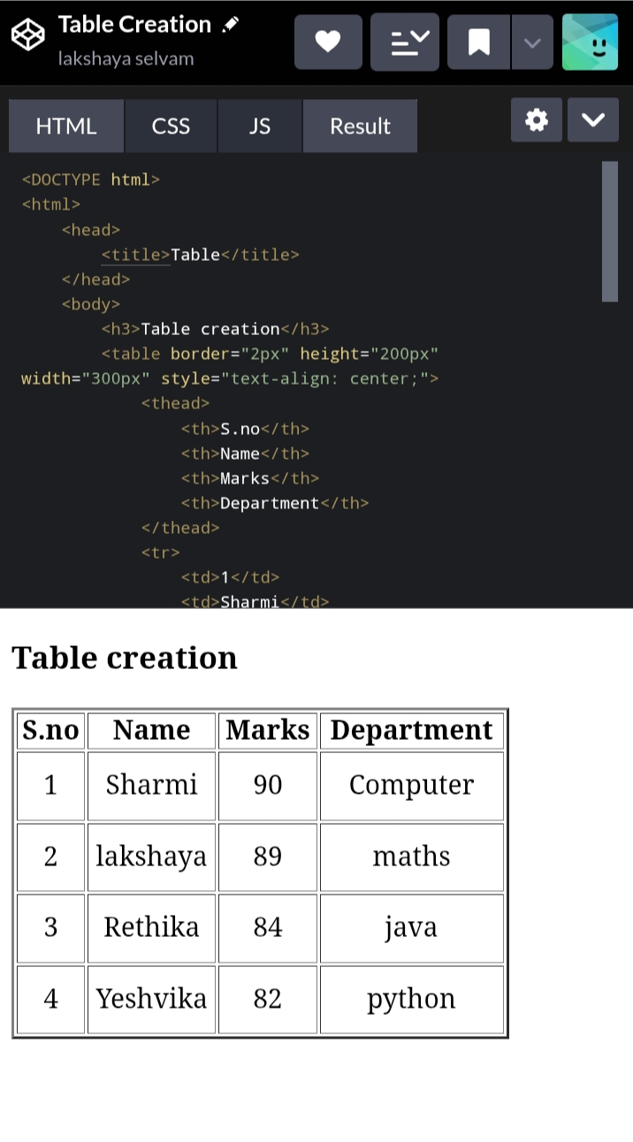
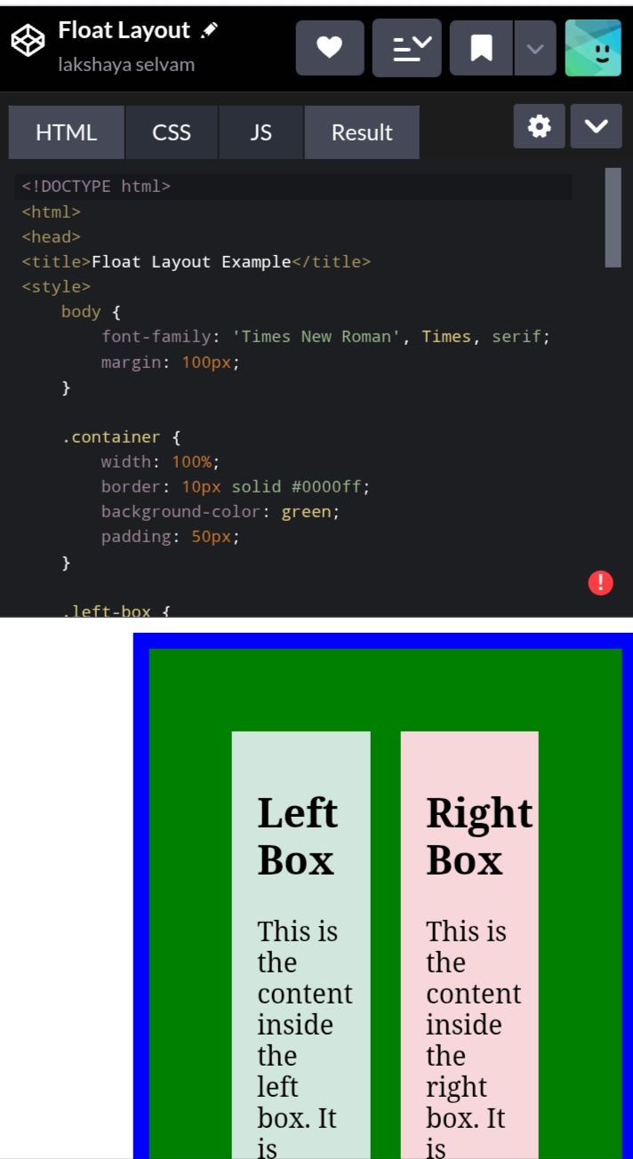
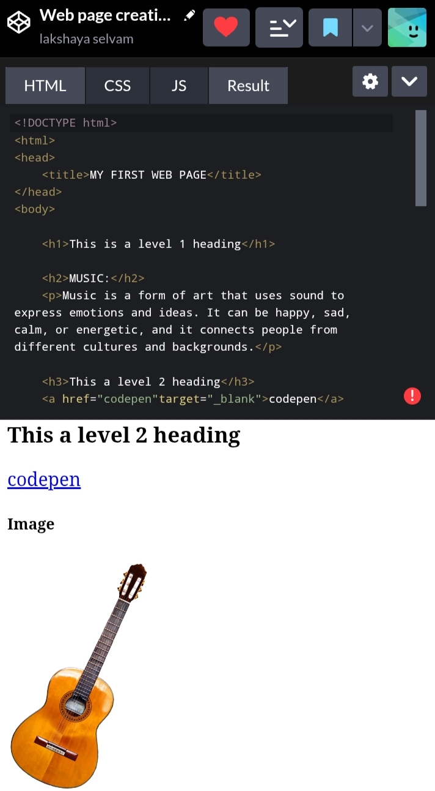
RESULTS AND SCREENSHOTS
10

Slide 11
CONCLUSION
Showcases skills and achievements digitally. Easy to update and share information. Helpful for students, professionals, and recruiters.
11

